Slide 1



P2 - Sustainable Supply Chain Performance Dashboard using Power BI & Improvisations made using the Super Stores Dataset
Name : V. Priya Dharshini
College Name : SASTRA Deemed University

Slide 2

Learning Objectives
The main learning objectives I would get out of this project is how to use Power BI, how to load a given dataset onto Power BI, transformation of dataset, creating multiple new tables from the given existing table, analysing the dataset, creating visuals and a final dashboard.
GOAL
Source :
www.freepik.com/

Slide 3
Tools and Technology used
For this project, mainly we use Power BI and excel to a very little extent. In fact, Power BI is quite sufficient for us to complete the whole project. Power BI is quite efficient when it comes to loading, transforming, creating relations between tables and helps us a lot in creating dashboards. It connects to various data sources, enabling data transformation and analysing using DAX and Power Query.

Slide 4
Methodology
First, I loaded the dataset into Power BI and cleaned the dataset using the “Transform Data”. I created multiple new tables from the given existing table and made the relations between them in the model view of Power BI. In the model view, I then created visuals and put all the visuals together to form the final dashboard. I used various kind of graphs and plots to analyse the data and come up to conclusions.

Slide 5
Problem Statement:
Some of the problem statements which had to solved for this dataset are:
How are the sales in each state?
How much is the total sales city-wise and region-wise?
How much is the average profit in each region?
What is the total shipping cost with respect to each shipping mode?
How much is the average unit price of each product category?
How are the month-wise profits?
How much is the total sales, total profit, total quantities ordered?
How are the discounts month-wise and region-wise?
What is the profit according to each product sub-category?

Slide 6
Solution:
The above mentioned problem statements have been solved and visually represented on the dashboard I created using Power BI. I used various graphs and plots like bar chart, pie chart, donut chart, line chart, cards, slicers and a lot more to get the analysis perfectly pictorially represented on the dashboard. Each and every plot depicted in the dashboard helps us to understand the dataset even better and where all the supply lacks, demand is more, is production sufficient and many other details.

Slide 7
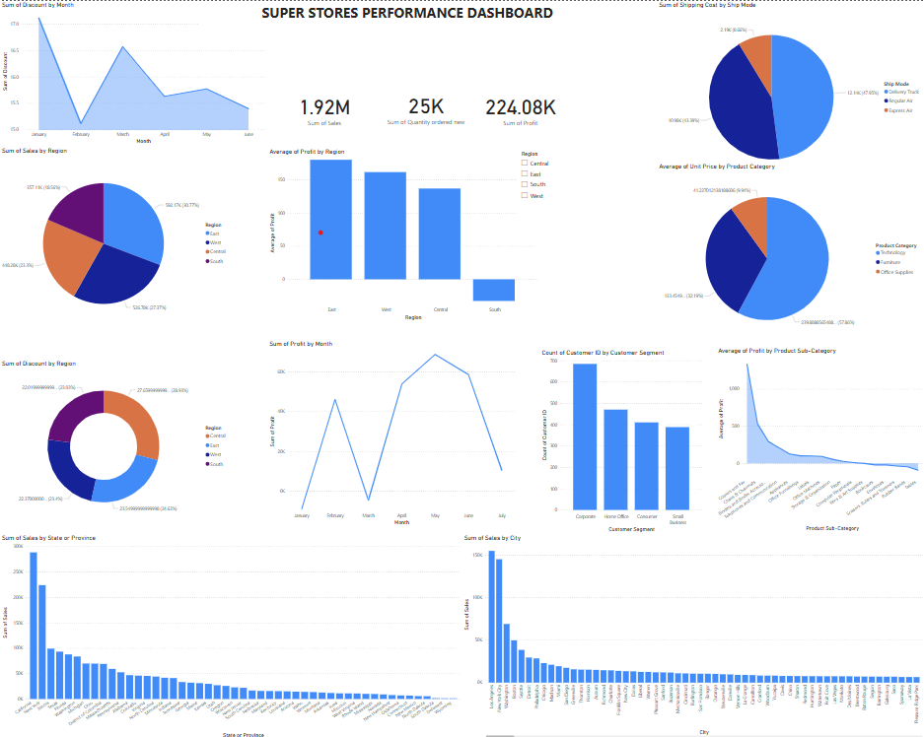
Screenshot of Output:

Slide 8
Conclusion:
From this project I got to learn how to use Power BI in a very detailed way and it is used to analyse any given datasets and how it can be used for any official purposes. With the help of mentoring sessions we were able to work on the Supply Chain dataset leaving us not much to explore, whereas the other dataset which we have taken and done ourselves has made us explore all the tools available in Power BI and made us gain a lot more knowledge.

